Slide 1
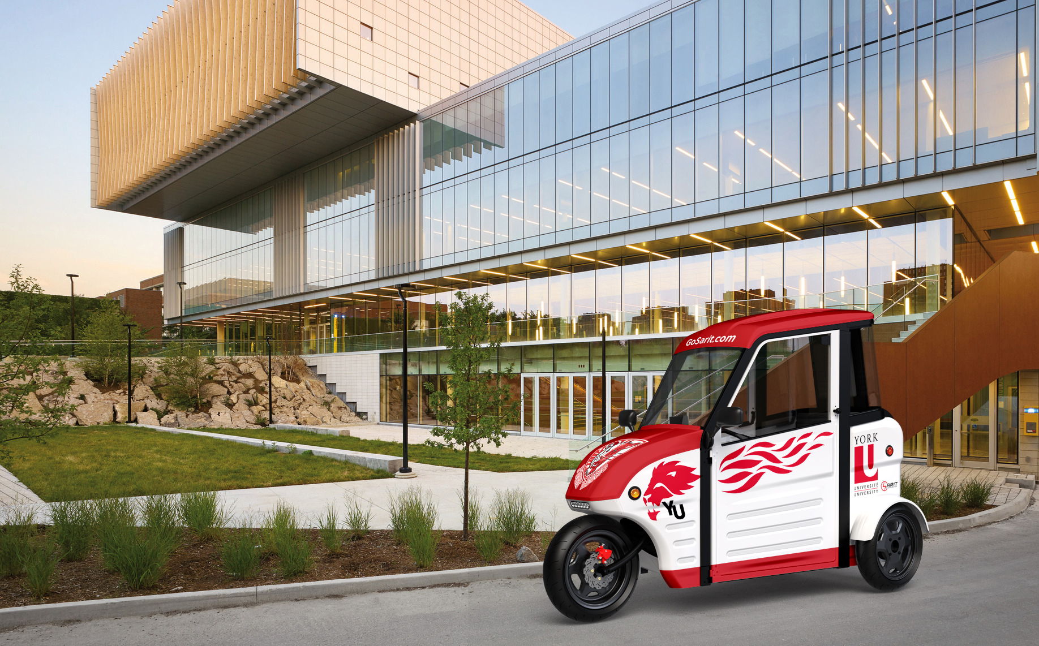
SARIT @ YORK
Ontario Smart Mobility Readiness Forum
INSIGHTS ON MICROMOBILITY
ARU RAMDAS
EXTERNAL RELATIONS MANAGER
Andrew Maxwell
Bergeron Chair IN TECHNOLOGY ENTREPRENEURSHIP

Slide 2
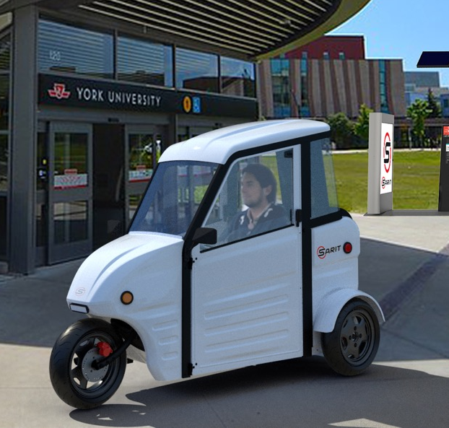
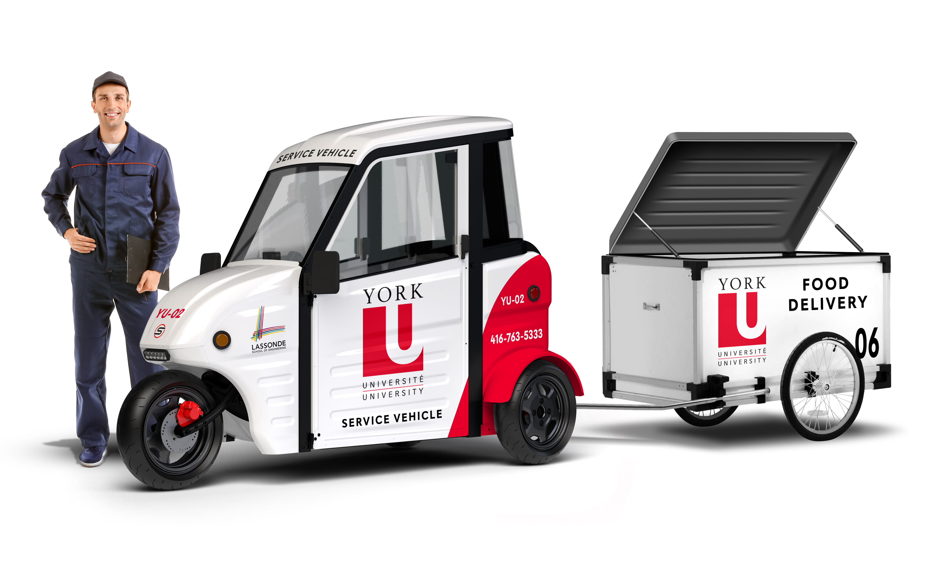

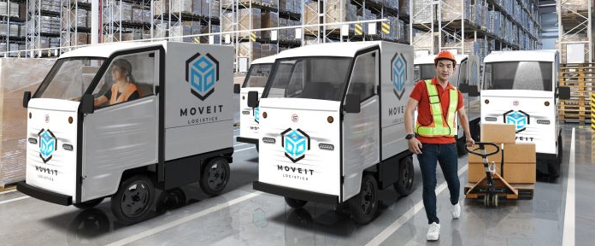

What are Micromobility Vehicles?
Urban Mobility Vehicles (UMVs)
Range 100 km
Max speed 32 km/hr
110 V Charges in 6.5 hrs
1 m. wide, 2 m. long
3 wheels, $25/day
Not MTO approved
Low Speed Vehicles (LSVs)
Range 100 km
Max speed 40 km/hr
110 V Charge in 3 hrs
1 m. wide, 2 m. long
4 wheels, $30/day
Versatile body styles
MTO approved
Notes:
Direct Benefits:
Reduced Transportation/Delivery Costs
Facilitated Campus Access/Enhanced Safety
Reduced Noise/Congestion/Parking/Emissions
Indirect Benefits
Economic impact/ cost reduction
Enhanced mobility (integrates with transit)
Showcases sustainability/innovation/equity
Strategic Benefits
Opportunities for multi-disciplinary research
Linked to provincial economic activities
Community engagement (i.e. Toronto, Markham)

Slide 3
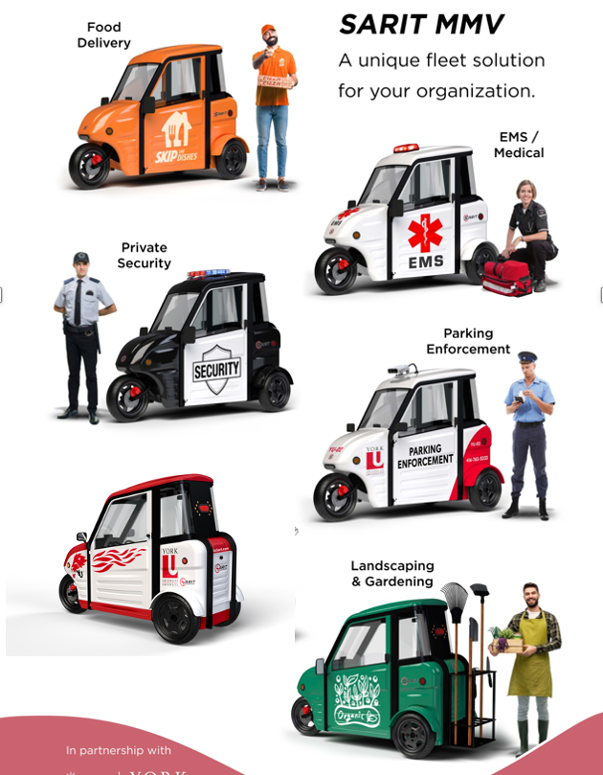
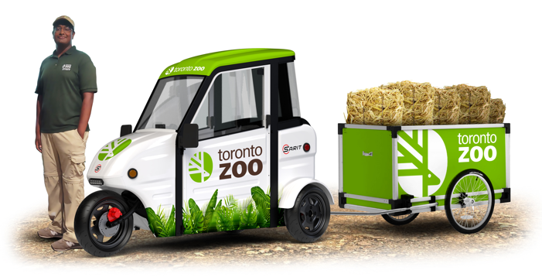
Ontario Smart Mobility Readiness Forum
Current use cases (YorkU, Toronto Zoo, Exhibition Place)
Benefits of Micro-Mobility Deployment
Addressing Municipal Challenges
Engage with us
1
2
3
4
Catering
Groundskeeping
Notes:
YorkU as a living lab: Focus on sustainability and Innovation
Mobility as a service – fleet electrification
Innovation and technological advances.
Barriers to adoption (Municipal and Provincial)
How they can engage.
How Safety Concerns can be addressed
Technology, education and enforcement technology integration

Slide 4
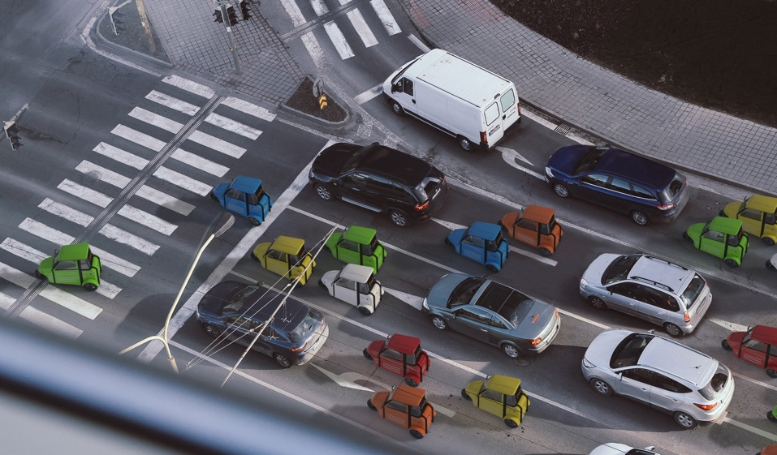
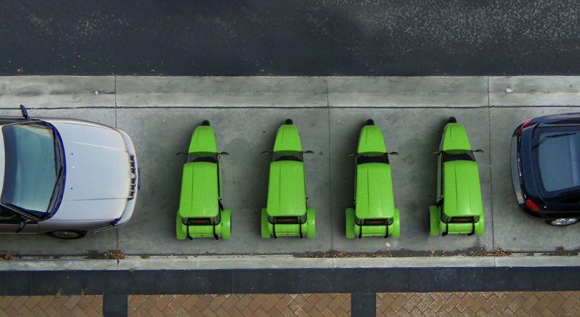
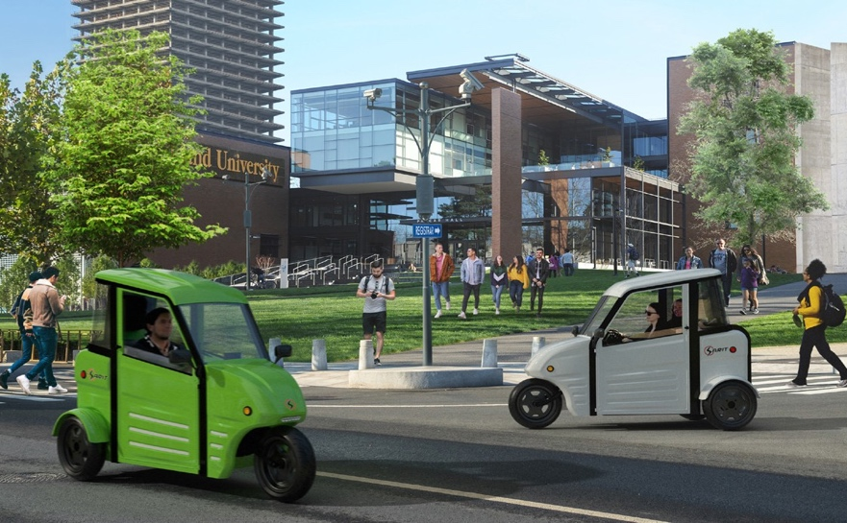
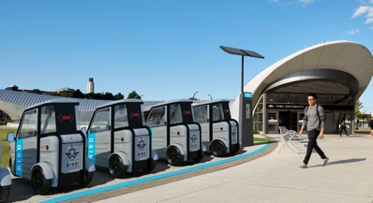
Addresses Current Urban Challenges
1
Reduces Congestion, Optimizes space utilization, Improves safety
2
Enhances Last Mile Deliveries, Reduces Transportation Costs
3
Facilitates Mobility, Creates New Value
4
Offers Transit Integration
5
Facilitates Transition to Zero-emission Fleets
Notes:
Research includes, technology, business, safety, ethics, risk…

Slide 5

Anticipating Future Municipal Challenges
Smart technology
Video-AI
AI recognition
Telemetry
Swappable Trailers
Smart ignition
Audible Warning
Geo-fencing
LIDAR
Vehicle tracking
Customizable bodies
Enhanced functionality
Pedestrian Detection
Facilities management
Vehicle location/optimization
Flexible multi-use deployment
Shared use/Zero Fleet deployment
Community Alert
Control access/parking
Object avoidance
Driver performance
Multiple use cases

Slide 6
How will micromobility….
transform municipal services, urban planning and infrastructure development
reduce urban congestion, enhance accessibility and mobility
increase transit use, enhance road safety, and enhance equity and housing affordability
reduce collisions with bikes and pedestrians, and improve driver performance
facilitate infrastructure management, maintenance and service levels
improve road discipline, manage multi-mode integration, & improve pedestrian zone access
reduce pollution and accelerate the transition to zero emission fleets
…..in your municipality?

Slide 7

CALL TO ACTION
Scan QR code to engage with us!
Help us co-ordinate federal, provincial and municipal standards to facilitate deployment
Identify promising applications that partners can deploy in your municipality
Work with us to identify promising use cases in your municipality that we can pilot
Visit our York Living Lab to explore how SARIT can address some of your pressing issues
Email: andrew.maxwell@lassonde.yorku.ca

