Slide 1
Planning an Equitable Shared Micro-mobility System
OVIN Webinar
26 June 2024

Slide 2
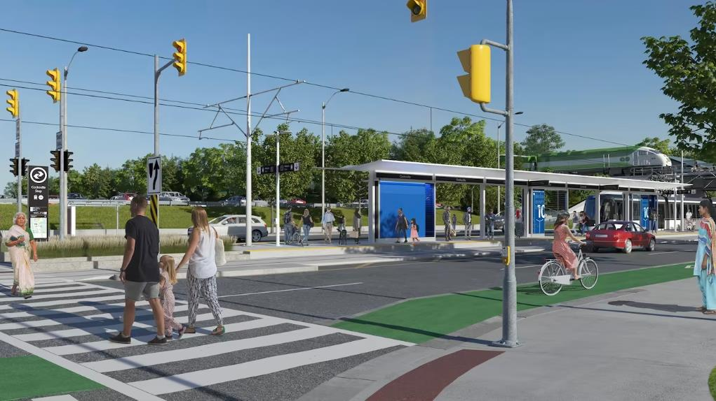
https://www.metrolinx.com/en/projects-and-programs/hazel-mccallion-lrt/what-were-building
Notes:
Our most vulnerable populations are most impacted by any type of change whether it be social, environmental, economic, health related or other. They are also the least likely to have the resources or opportunities available to adapt to increase pressures from those changes, especially when they are compounded. So as transportation professionals, whenever we propose program, policy or network changes, we need to ensure that we keep equity at the forefront of our decision making.
But what is transportation equity? In Mississauga we see it as the Freedom to Move.
The freedom to move is at the heart of the Transportation Master Plan Vision for Mississauga, meaning everyone and everything will have the freedom to move safely, easily, and efficiently to anywhere at any time. Quality of life in the city depends on individuals having reliable access to the people, places, and things they need and enjoy. That access must be available to all people, regardless of their reason for travelling, time of travel, destination, journey length, or personal circumstances.
This is where micro-mobility comes into play:

Slide 3
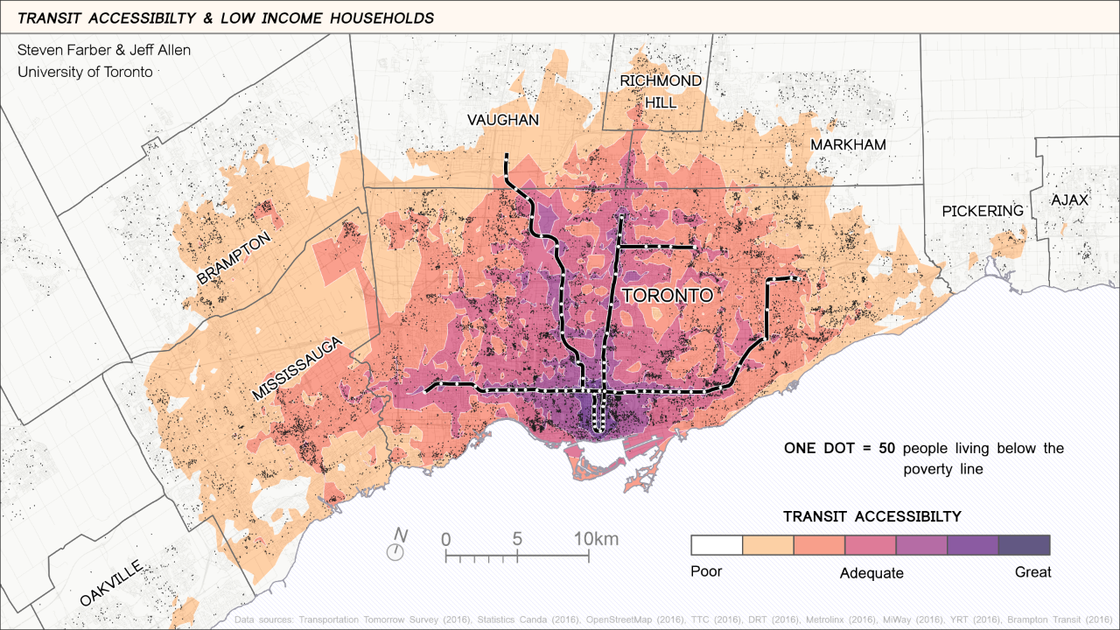
Notes:
Each individual interacts with the City’s transportation system differently and has a unique set of criteria required to meet their everyday needs. The more transportation options that are available, the more likely it is that everyone’s mobility needs can be met.
With current transportation options, 40% of all low-income residents in major Canadian cities are at risk of transport poverty
In Mississauga we can see that transit accessibility is quite low, leaving limited options for those who do not own a private vehicle. Micro-mobility devices offer mobility option that can meet the needs of those not yet served by the City’s existing transportation system.

Slide 4
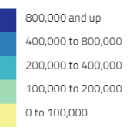
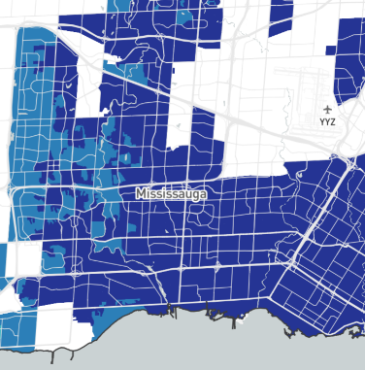
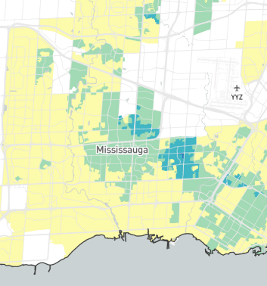
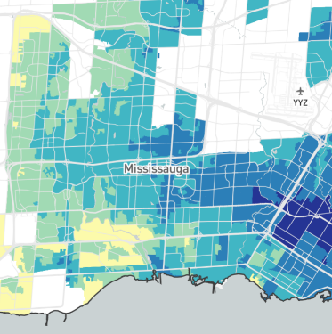


30 minutes
30 minutes
60 minutes
(Jeff Allen, 2018)
Notes:
Getting into more detail on what transportation access in Mississauga looks like right now, we have a few maps showing the time it takes to access jobs using different modes of transportation
Within a 30 minute drive by car, you have access to over 800,000 jobs
For a 30 minute bus ride this drops to about 200,000 jobs or less.
Even a 60 minute bus ride does not come close to providing the same access to jobs as a 30 minute car ride.
In Mississauga 47% of households have 1 car or less, meaning not everyone has access to a car and not everyone has access to the same number of opportunities.

Slide 5
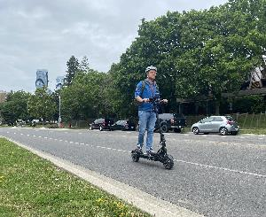
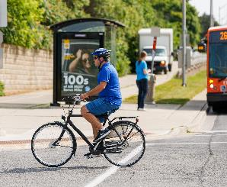
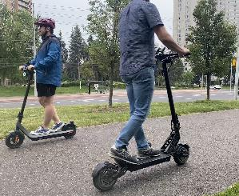

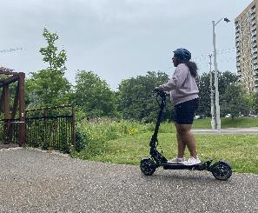
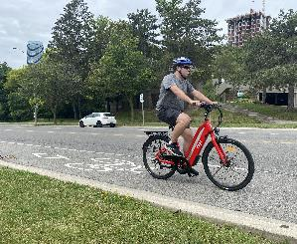
Notes:
To help address these gaps, the City of Mississauga has been planning a Share Micro-mobility Program.
The program is set to launch on June 21st. It will be a privately owned and operated system of e-bikes and e-scooters in partnership with two service providers, Bird and Lime.

Slide 6
Planning Process
2018
Cycling Master Plan
2019
Direction from Council
2020
Provincial E-scooter Pilot
2021
Opted into Provincial Pilot
2022
Ongoing Studies
2023
Council Approval
2024
Contract Award and Program Launch
Notes:
But before we got to this point, there was a lot of planning that took place over the years.
Several key City policy documents supported a shared micro-mobility program in the City, including: the Transportation Master Plan, Smart Cities Master Plan, Climate Change Action Plan, Economic Development Strategy, and the 2018 Cycling Master Plan, which recommended exploring the feasibility of a bike sharing system in Mississauga. This Policy support is what kick started the program.
So in 2019 a report on micro-mobility Mississauga, was presented to council and Staff were directed to initiate the development of a regulatory framework to encourage and enable a phased introduction of micro-mobility systems in the City.
Not too long after, the Province announced the start of the e-scooters pilot. Mississauga opted into the Provincial Pilot in 2021 to allow the use of privately owned e-scooters.
Between 2020 and 2023, a number of studies and consultations were conducted to better understand what an equitable micro-mobility program would look like in Mississauga. These included a cross-departmental visioning session which led to the development of eight strategic pillars intended to guide the micro-mobility project. A study to identify a recommended vehicle type, system model, and governance model most appropriate for the City, and an analysis of micro-mobility potential across the city to determine the number of devices and parking locations that would best serve the city.
In 2023 we finalized the procurement details before getting approval from council to go to tender.
Earlier this year we completed the procurement and awarded the contract to two service providers.

Slide 7
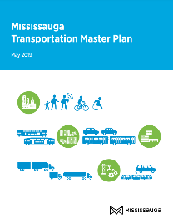



Micro-mobility Program Development
Notes:
Several key City policy documents supported a shared micro-mobility program in the City, including: the Transportation Master Plan, Smart Cities Master Plan, Climate Change Action Plan, Economic Development Strategy, and the 2018 Cycling Master Plan, which recommended exploring the feasibility of a bike sharing system in Mississauga. This Policy support is what kick started the program development.​
​
In 2019 a report on micro-mobility in Mississauga, was presented to council and Staff were directed to initiate the development of a regulatory framework to encourage and enable the introduction of micro-mobility systems in the City.​

Slide 8
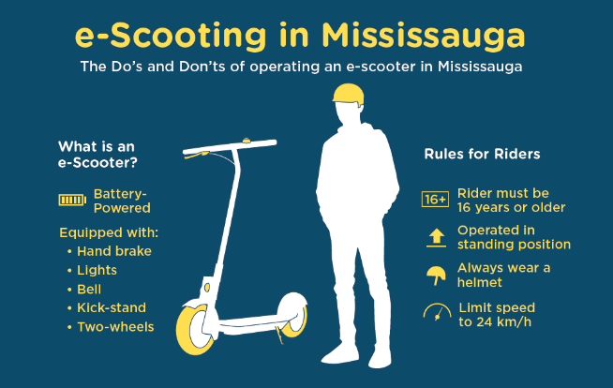
Provincial E-scooter Pilot
2020
Pilot Launch
2021
Opted into pilot
Ongoing
Monitoring
Notes:
Shortly after that direction from council, the province announced they would pilot the use of e-scooters in Ontario.
Note that e-bikes are permitted in the province but e-scooters are being piloted
Province launched pilot in 2020
Mississauga Opted into pilot in 2021: by amending our traffic transit and parks by-laws to permit the use of e-scooters on roads with speed limits of up to 50 km/h and on cycling infrastructure like bike lanes, and multi-use trails next to the road.
We are now monitoring the use of personally owned e-scooters as requested by the Province and tracking data related to concerns and injuries. The province will use the information collected form municipalities to inform the future of the pilot.

Slide 9



Micro-mobility Program Development
In 2022 General Committee received the corporate report entitled “Micro-mobility Program Development Phase 1 Final Report”
Recommending a privately owned and operated system that provides both electric pedal-assist bicycles and electric kick-style scooters in a hybrid model permitting docked and dockless parking.
Privately Owned
&
Privately Operated
Notes:
Read bullets on slide…
…Council subsequently approved this recommendation, giving staff the go-ahead to develop an implementation plan for the program

Slide 10
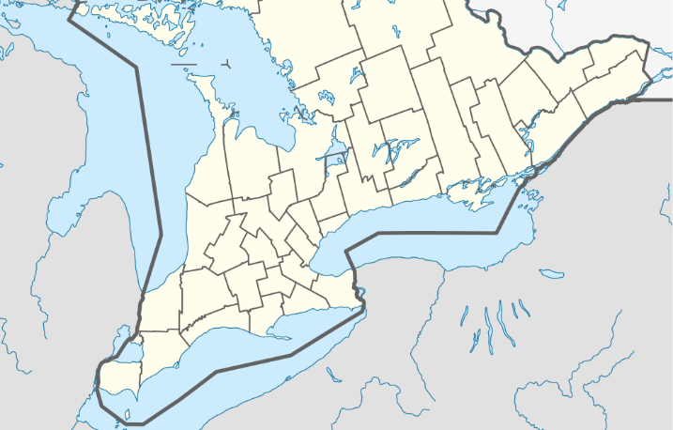
Shared Systems in Ontario
  Bike and/or e-bikes: City of Toronto
  Bike and/or e-bikes and e-scooters: City of Windsor, City of Hamilton, Region of Waterloo
  E-scooters: City of Ottawa, City of Brampton, City of Oshawa, Town of Ajax
Notes:
A number of other municipalities in Ontario have shared systems…

Slide 11
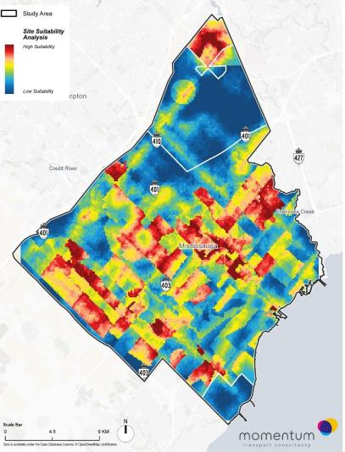
System Overview
Shared micro-mobility vehicles are to be offered city-wide
Initial fleet: 900 e-scooters and 300 e-bikes
The system will provide 400 parking locations (city-wide) and support a hybrid model of docked and dockless parking.
Estimated 1,500 to 2,000 daily trips.
Notes:
A further study on 2023 evaluated the potential for micro-mobility use across the city and helped determine how many where e-bikes and e-scooters should be offered, how many should be available, and how many parking locations we would need to support a shared system in Mississauga.
…Read stats from slide…

Slide 12








Monitoring & Evaluation Framework
Accessibility and Ease of Use
Addressing Climate Change
Building Sense of Community
Education
Leverage and Partner with Business
Mobility as A Service
Safety
Supporting
Infrastructure and Policies
Notes:
As you saw in the previous slide there was a lot of planning that went into developing the program. Layers of studies, policy updates, engagements, and education that brought us to where we are today. And while equity was built into the planning process, once the program is launched, we wanted to make sure it remained equitable and that the goals we set early on continued to be met.
So in 2023 we had a Masters of Urban Innovation Student from the University of Toronto Mississauga hired to help build a Monitoring and Evaluation Framework
Building the framework:
We used the eight pillars defined in the visioning session earlier on in the planning process as the goals of the program and built on those goals to form the framework, ensuring known concerns or issues (like accessibility, speeding, etc.) would be monitored.
As you can see Equity is not its own pillar in this framework, but that’s because it is embedded in every goal and objective throughout the framework and forms the foundation for this program.

Slide 13
Equitable Shared Micro-mobility Program
The City of Mississauga defines an equitable shared micro-mobility program as one that increases access to affordable mobility options for people regardless or their race, ethnicity, income, gender, age, sexual orientation, primary language, immigration status, or other markers of social identity. An equitable shared micro-mobility program in Mississauga will be planned and operated so that people from marginalized communities have the ability to influence decisions in a way that addresses their needs and concerns.
Notes:
With that in mind, it was important that we defined what an equitable shared micro-mobility program in Mississauga should be. Having a set definition for equity in our program ensured it was accurately reflected its goals and objectives and that all parties involved in the program continue to work towards the same outcomes.

Slide 14
Monitoring & Evaluation Framework
Goal
Objective
Indicator
Indicator
Objective
Data
Data
Details
Notes:
So, how does the M&E framework work?
each of the eight goals we discussed in the previous slide were broken down into objectives, each objective was given indicators of success, and each indicator has several data points that we will be collecting to monitor them. Each of those data points is detailed, noting information on how it will be collected, how often, who is responsible, how it will be analyzed, etc.
In the next few slides we will go into more detail on each of the goals and objectives. Unfortunately, we don’t have time to get into each indicator or data point but I’m always available for questions if you’re interested in finding out more.

Slide 15
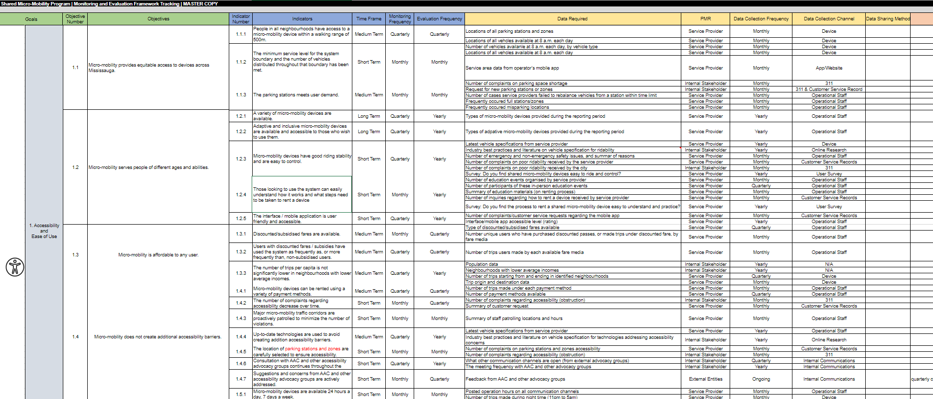
Notes:
This is what it would look like for one of our goals
In the next few slides we will go into more detail on each of the goals and objectives. Unfortunately, we don’t have time to get into each indicator or data point but I’m always available for questions if you’re interested in finding out more.

Slide 16
Implementation Process
Proposals & Evaluations
Contract Award & Service Agreement
Detailed System Planning
Program Launch
Q1 2024
Q2 2024
Notes:
Presented all of this information to General Committee in October 2023 and received approval to move forward with the implementation process, bringing service providers on board to provide a shared micro-mobility program for Mississauga.
Earlier this year we put out a request for proposals and received 4 submissions. The proposal evaluation was a multi-stage process which included both written submissions and a field test and interview component. A team of staff from different departments evaluated the proposals and the top 2 bidders were chosen as service providers for the City. Each SP will be permitted to deploy their devices across the entire City.

Slide 17
Mississauga’s Shared Micro-mobility Program – Request for Proposals
- Staffing and Human Resources
- Customer Service
- Operations (maintenance, rebalancing, compliance, enforcement, etc.)
- Marketing, Education, and Communication
- The System (vehicles, parking, service areas, regulated zones, etc.)
- Pricing Structure and Payment Elements
Notes:
These are some of the larger categories included in each of the proposals we received. Note that questions around safety and equity were included in each of these sections.
We asked questions about their staffing and the resources they will have to run the system. Both service providers will have teams based in Mississauga to ensure the program runs smoothly.
Both service providers will have e-bikes and e-scooters available for use. Parking for both will be hybrid with some fixed parking locations and the ability to park at bike racks closest your destination and the vehicles will be available across the City.
The payment options, prices, memberships, and discounted passes for both of the providers will be different. We will be finalizing those details in the next few months but more information will be released closer to the program launch. The benefit of having two providers is that there is some competition when it comes to pricing and people can chose the provider that works best for them.
We asked questions around how they would run the system. Both providers will have regular maintenance scheduled to ensure the vehicles remain charged, safe, and functional. They will both use a number of tactics to keep the devices spread across the City and make sure users are following the rules of the road and proper etiquette when riding or parking the vehicles.
Both service providers will have a number of customer service channels available 24/7 for questions or concerns. There include the app, a phone number, website, email, and a direct reporting form available by scanning a QR code on any of the vehicles.
Education is also a very important part of this program. Both service providers will employ a number of education tactics to ensure everyone knows how to safely use the vehicles and interact safely with other road users. These tactics include things like social media posts, attending in person events, and hosting training workshops across the city.

Slide 18

Monitoring & Evaluation Framework
Avoid creating accessibility barriers to the extent possible and ensure systems are available for use to all residents (geographically, financially, temporally, and physically).
  Provide equitable access to devices across Mississauga.
  Serve people of different ages and abilities.
  Is affordable to any user.
  Does not create additional accessibility barriers.
  Is available any time of the day and throughout the year.
Accessibility and Ease of Use

Slide 19

Monitoring & Evaluation Framework
Reduce vehicular traffic congestion/move people rather than cars and improve mode share for active transportation.
  Micro-mobility decreases carbon emissions by moving people rather than cars.
  The lifecycle carbon footprint of micro-mobility devices is minimized.
  Micro-mobility system utilizes low carbon materials
Addressing Climate Change

Slide 20

Monitoring & Evaluation Framework
Nurture community by developing a vested interest in micro-mobility, including public art components.
  Connect people to parks, services, and amenities, as well as members of their community.
  Improve the health of community members.
  Contribute to the liveliness of the public realm.
  Is accepted and welcomed by community members.
Building a Sense of Community

Slide 21

Monitoring & Evaluation Framework
Improve understanding of the rules of using micro-mobility.
  Users understand the rules of the road and trail etiquette.
  Users are aware of how to operate the different devices.
  Both users and non-users are encouraged to submit inquiries and complaints.
  Other road users know how to safely interact with micro-mobility users.
  Users understand key risks (e.g., riding at night, no helmet, alcohol use) and know what protective measures are available to avoid them.
Education

Slide 22

Monitoring & Evaluation Framework
Monetize or capitalize on the presence of micro-mobility, including sponsorship and the use of micro-mobility vehicles for goods movement.
  Drive growth and innovation for the local economy.
  Create business opportunities for the City.
  Enhance labour force mobility and goods movement in the city
Leverage & Partner with Business

Slide 23
Monitoring & Evaluation Framework
Monetize or capitalize on the presence of micro-mobility, including sponsorship and the use of micro-mobility vehicles for goods movement.
  Drive growth and innovation for the local economy.
  Create business opportunities for the City.
  Enhance labour force mobility and goods movement in the city
Leverage & Partner with Business

Slide 24

Monitoring & Evaluation Framework
Provide a wide variety of ways to move around the city, including combining modes of travel.
  Provide a positive user experience.
  Ensure inquiries and complaints are responded to promptly.
  Integrate with transit systems and encourage multimodal trips.
  Provide people with freedom to move.
Mobility as a Service

Slide 25

Monitoring & Evaluation Framework
Build complete streets, including separated active transportation corridors.
  Micro-mobility infrastructure contributes to safe and orderly system operations.
  Micro-mobility devices meet provincial and municipal standards.
  Users have access to safe infrastructure in line with the goals of Vision Zero.
  There are 0 fatalities and 0 serious injuries related to the use of micro-mobility devices.
Safety

Slide 26
Monitoring & Evaluation Framework
Create a robust and sustainable financial model, address liability and risk.
  Micro-mobility regulations contribute to safe and orderly system operations.
  Fees and pricing allow the City and service providers to maintain sustainable financial models.
  Addresses liability and risk by establishing a comprehensive legal framework.
  Provides insightful data for public sector improvement.
  Follows Equity Diversity & Inclusion best practices
Supporting Infrastructure and Policies

Slide 27


What We’ve Learned
The importance of setting a strong foundation for a program
Monitoring & Evaluation is going to be a lot of work
We still have a lot to learn
Notes:
1) Having strong goals for the program early on and building a monitoring and evaluation framework prior to going to tender allowed us to clearly articulate the program goals in our request for proposals
Equity considerations were built into our RFP (example: Living wage, Diverse, inclusive, and equitable workforce, Memberships/discounted passes, accessibility, Minimum coverage throughout the City, Transit integration, diversity of education and marketing materials and strategies), and as a result we saw the majority of our goals and objectives reflected in the proposals we received.
Defining equity and setting clear goals ensures everyone is on the same page going into the program launch.
2) The monitoring and evaluation framework has over 100 indicators of success and even more data points that will need to be collected and evaluated to make sure the program stays on track. That’s going to be a lot of work! With that in mind we’ve already identified a number of potential partnerships with post secondary institutions and research groups to help
3) We still have a lot to learn, micro-mobility is a fast-evolving sector in transportation and transportation equity best practices continue to evolve. Our monitoring and evaluation framework, and by extension the shared micro-mobility program itself is intended to be flexible and adapt to those changes. Every webinar, conference, research paper, or networking opportunity has continued to shape our understanding of transportation equity and will continue to influence our program’s goals and objectives to ensure it contributes to creating an equitable transportation system in Mississauga.

Slide 28
Thank You!
Matthew Sweet
Manager, Active Transportation
matthew.sweet@mississauga.ca
Mattea Turco
Transportation Planner
mattea.turco@mississauga.ca
Notes:
1) Having strong goals for the program early on and building a monitoring and evaluation framework prior to going to tender allowed us to clearly articulate the program goals in our request for proposals
Equity considerations were built into our RFP (example: Living wage, Diverse, inclusive, and equitable workforce, Memberships/discounted passes, accessibility, Minimum coverage throughout the City, Transit integration, diversity of education and marketing materials and strategies), and as a result we saw the majority of our goals and objectives reflected in the proposals we received.
Defining equity and setting clear goals ensures everyone is on the same page going into the program launch.
2) The monitoring and evaluation framework has over 100 indicators of success and even more data points that will need to be collected and evaluated to make sure the program stays on track. That’s going to be a lot of work! With that in mind we’ve already identified a number of potential partnerships with post secondary institutions and research groups to help
3) We still have a lot to learn, micro-mobility is a fast-evolving sector in transportation and transportation equity best practices continue to evolve. Our monitoring and evaluation framework, and by extension the shared micro-mobility program itself is intended to be flexible and adapt to those changes. Every webinar, conference, research paper, or networking opportunity has continued to shape our understanding of transportation equity and will continue to influence our program’s goals and objectives to ensure it contributes to creating an equitable transportation system in Mississauga.

