Slide 1
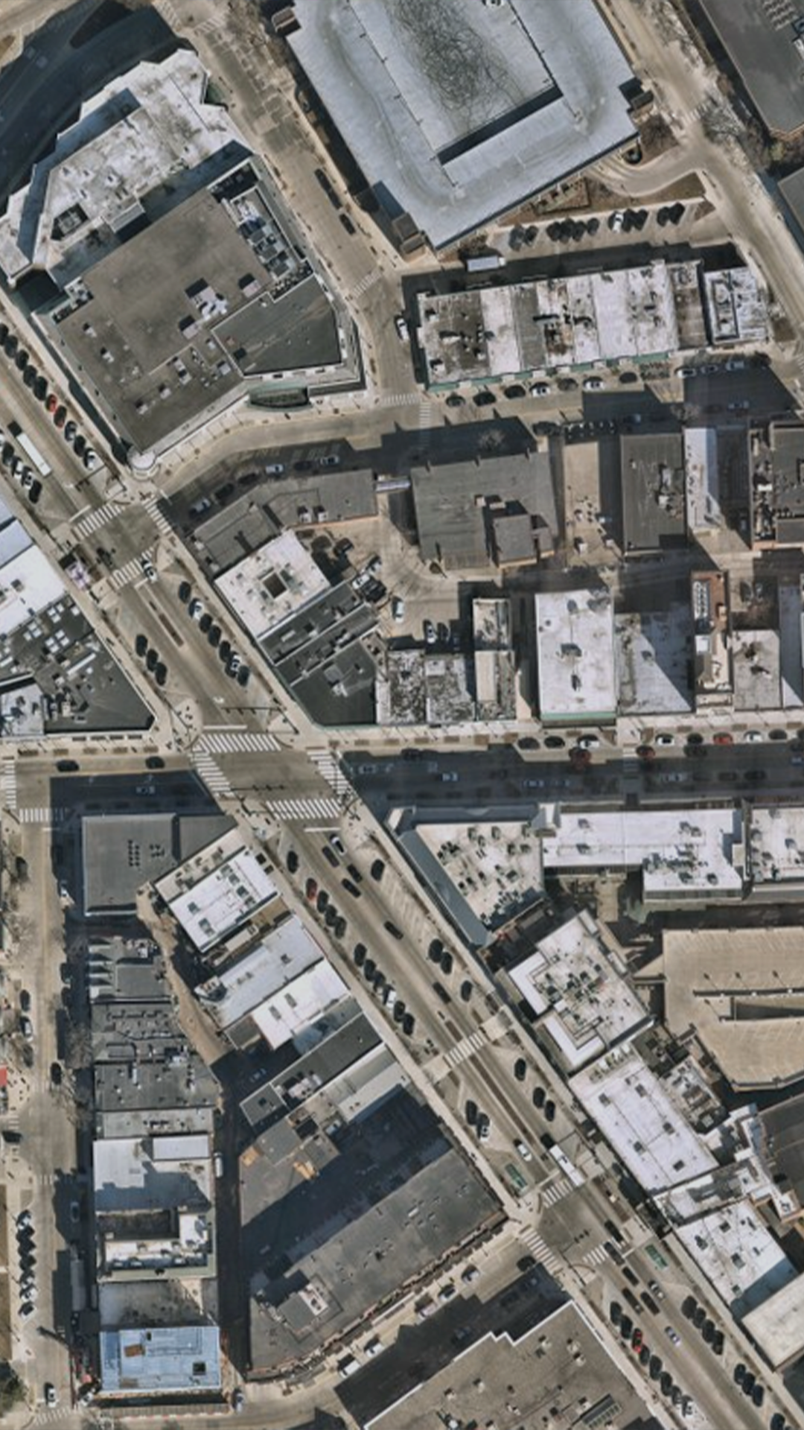



Revolutionizing
Smart Mobility
Through AI-driven Mapping
Notes:
We are GeoMate and our mission is to revolutionize Smart Mobility Through AI-driven Mapping. Let me explain how.

Slide 2
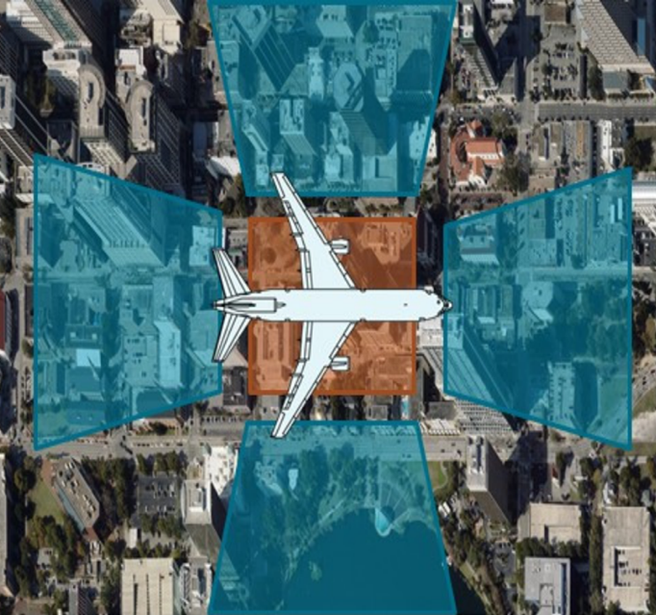
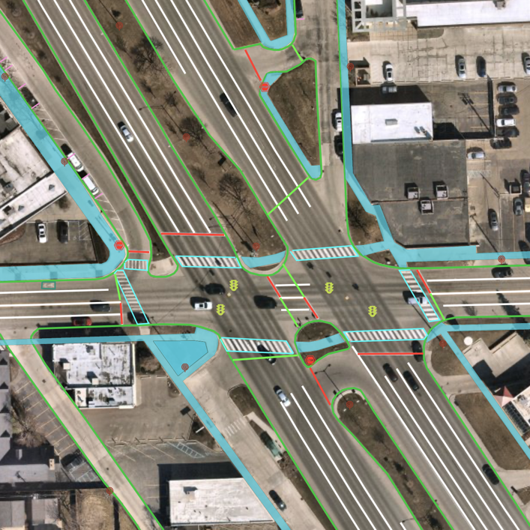
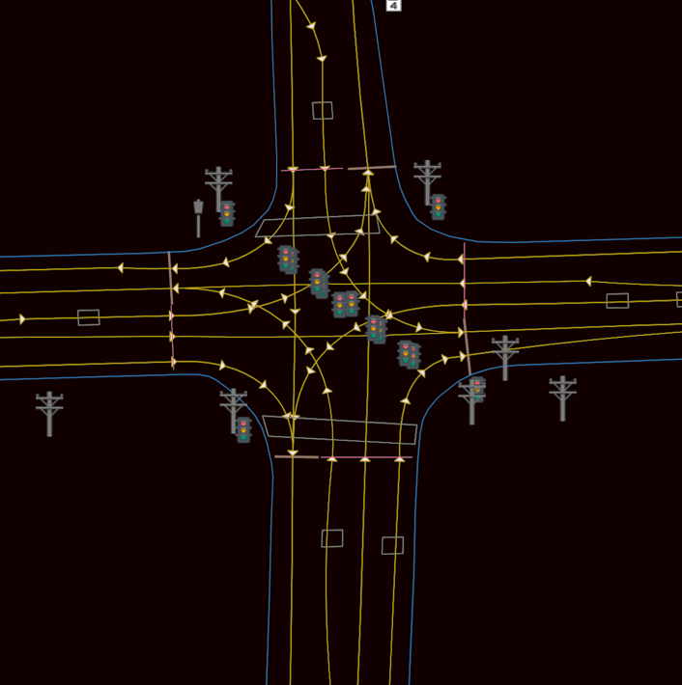
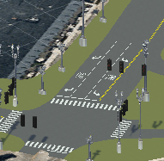
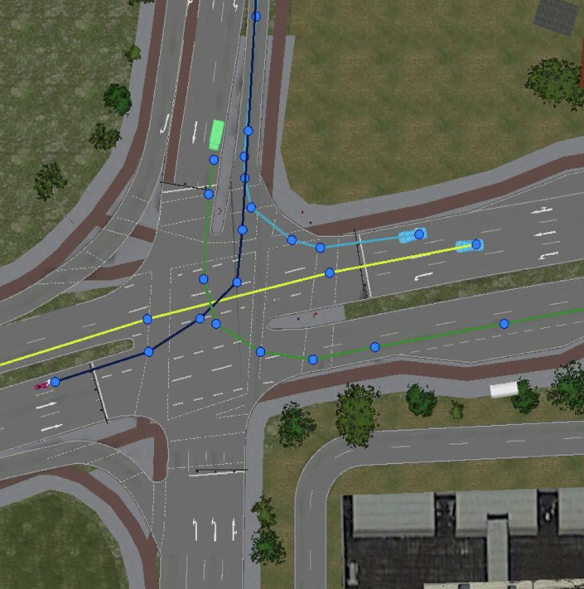
Geomate’s AI-Driven Maps
Our process:
Oblique 1
Oblique 4
Oblique 2
Oblique 3
Data Acquisition
& Preparation
Detection, Segmentation, & Fusion
Real World Construction
Content Ready Map for Simulation
Semantics & Traffic Rules
Notes:
GeoMate stands out in addressing the mapping challenges faced by Autonomous Vehicles through our AI-driven technology that seamlessly integrates with vehicle’s sensor data.
Our process is structured around three core components. Firstly, we start with efficient data acquisition, leveraging comercially available aerial and satellite imagery as a cost-effective alternative to lidar. This approach not only trims data acquisition costs but also results in significantly smaller data sizes. Secondly, we employ cutting-edge computer vision technology that autonomously maps over 35 features of the built environment. This efficiency not only reduces expenses but also enables the creation of highly detailed maps much faster. Thirdly, we leverage AI-based semantic annotation, allowing our algorithms to autonomously add semantic information and integrate traffic rules into our maps. This reduces the need for extensive human involvement in the mapping process. Ultimately, we construct a digital representation of the real world to meet our clients' needs, and our maps are also transformed into content-ready data for use in virtual testing scenarios for autonomous driving in simulation environments.

Slide 3
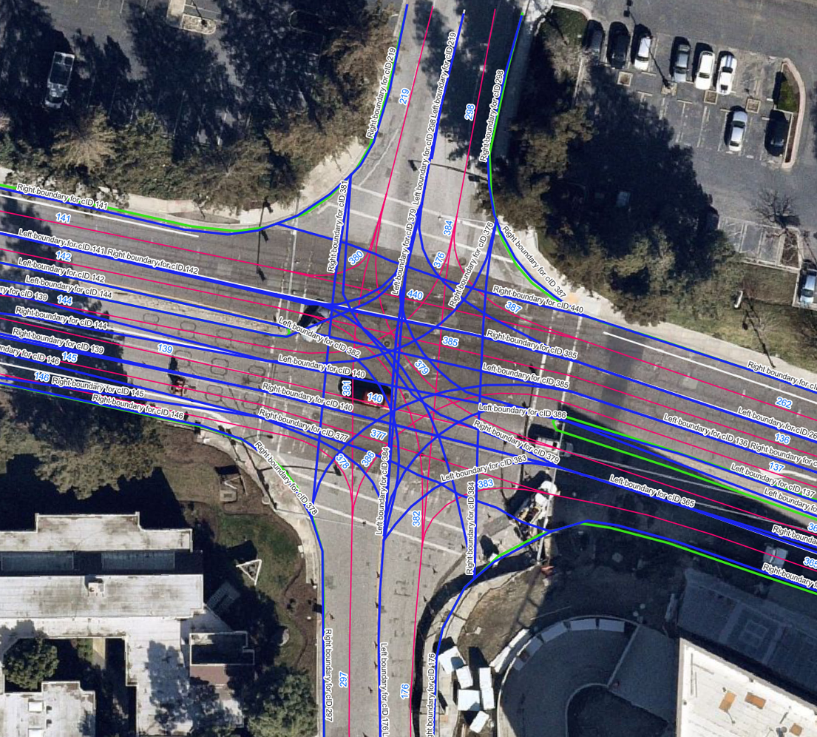
GeoMate’s Proprietary Technology
Reduce costs by up to 70%
Generate maps 3X faster
Increase computational efficiency
Notes:
To tackle mentioned challenges, we have developed an innovative approach. Instead of relying on traditional LiDAR technology, we utilize high-resolution geospatial imagery to produce HD maps.
******
This advanced method cuts costs by 70%, triples the speed of map creation, and significantly increases computational efficiency.

Slide 4
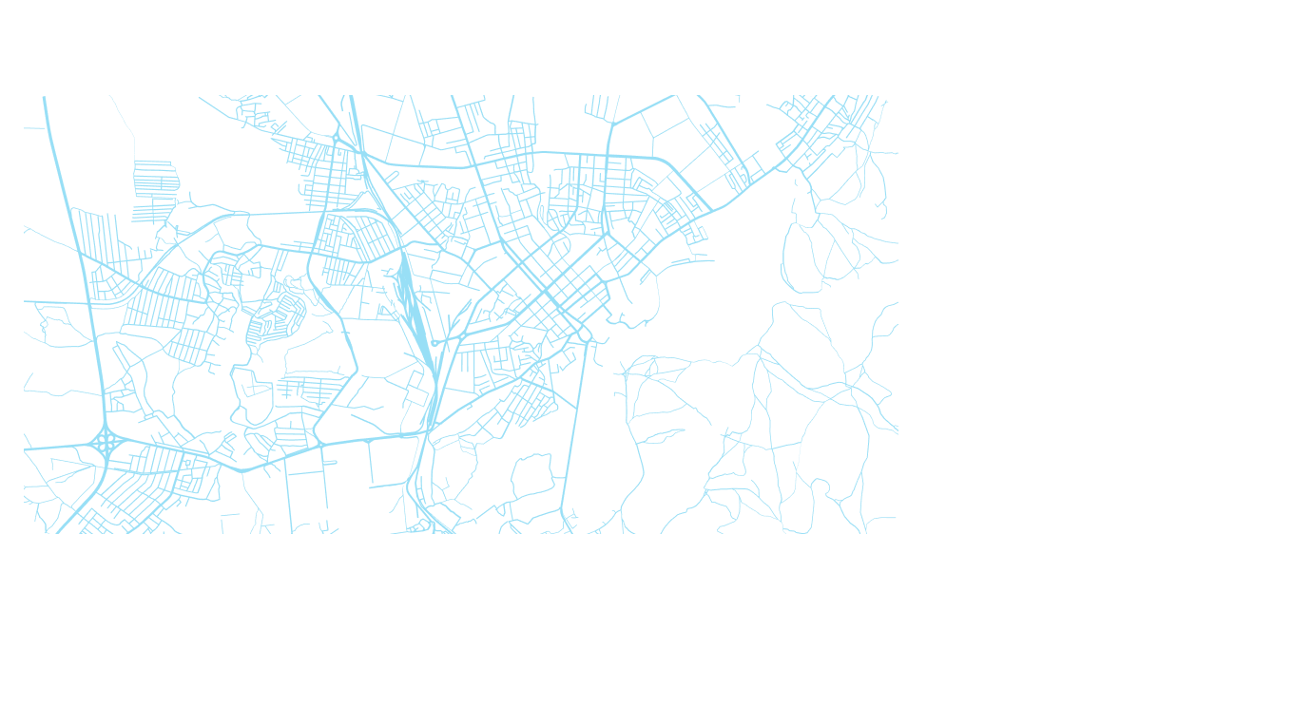
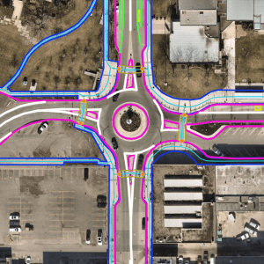
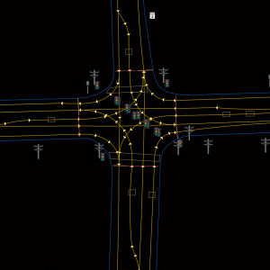
How our maps support Cities:
HD Map
Urban
Planning
Autonomous
Driving
TRANSPORTATION
GIS/Tree Canopy
Micromobility
TEST & VALIDATION
DEPLOYMENT
Notes:
HD maps are crucial not only for autonomous driving but also for adjacent sectors. They are fundamental to the operation of Delivery Bots and Robo Taxis and are a key component in ADAS in both real-world and simulated environments. Furthermore, HD maps have significant applications in urban planning. Cities and consulting firms utilize these detailed maps in the design and development of urban areas. They facilitate effective planning for infrastructure, traffic management, pedestrian safety, and the seamless integration of autonomous transportation systems.

Slide 5
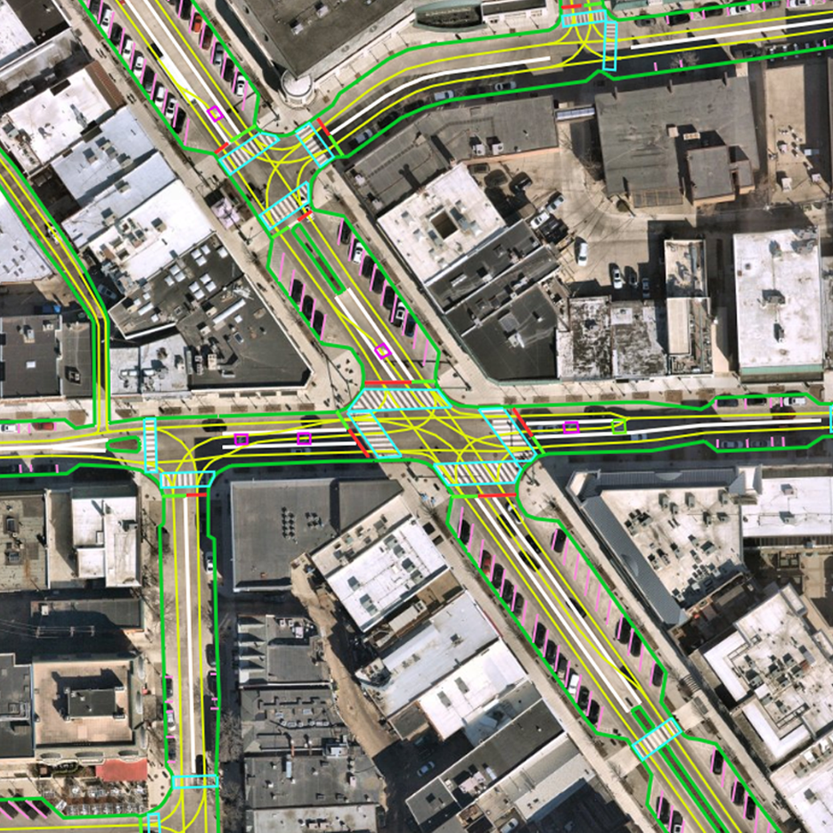
 | HD Map | Standard Map
Geometry | Lane Model Localization Model | Basic layout of road infrastructure
Semantics | Topologies between road elements | Not Available in Standard Map
Precision | High Precision | Low Precision
Format | Open Drive LaneLet2 | Geojson Shapefile
Purpose | Localization Perception Lane-Level Navigation | Urban Planning
Notes:
******
To mitigate this challenge, most of Autonomous Driving companies integrate High Definition maps into the software stack, that are being treated as an additional sensor enhancing the vehicle's capabilities.
Highlight the purposes - As we established with Melanie on our last all, the City of Kitchener has mature data. You guys have great Standard GIS maps.
To get AD’s up and running in the City however, you need HD maps, they are completely different.
Touch on the lane semantics - and the purposes.

Slide 6

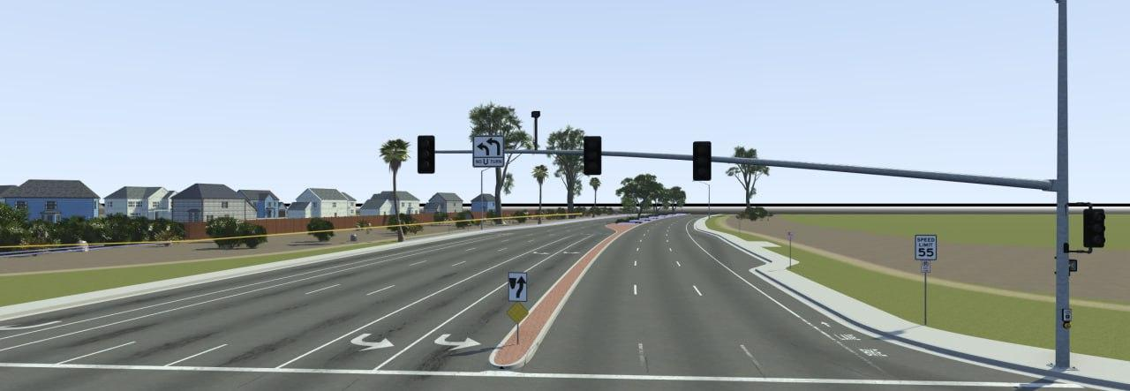
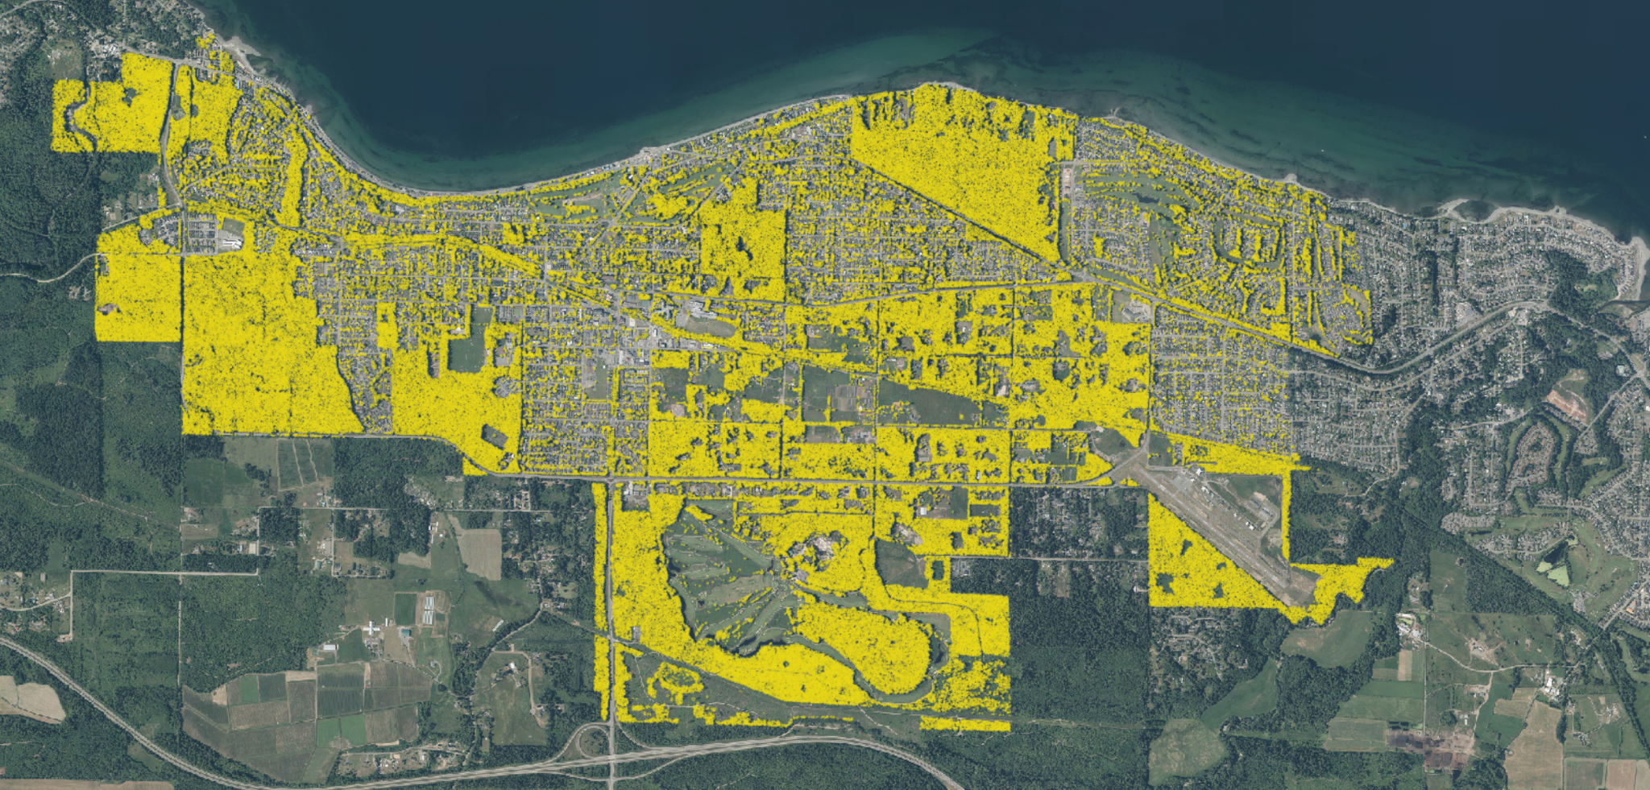
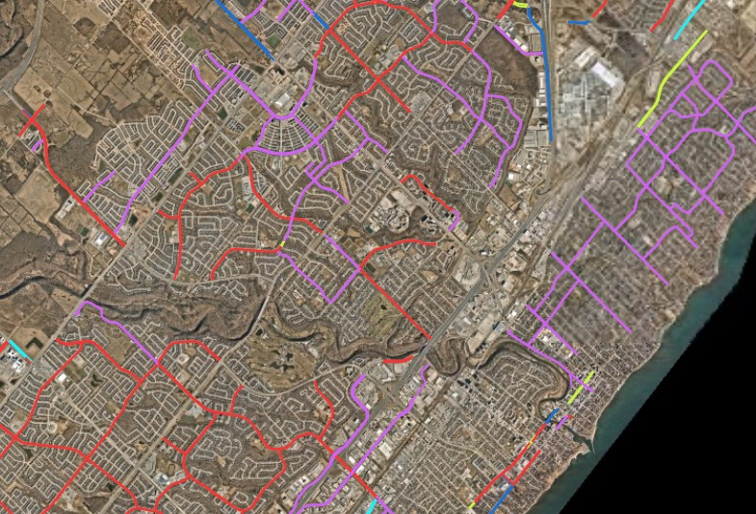
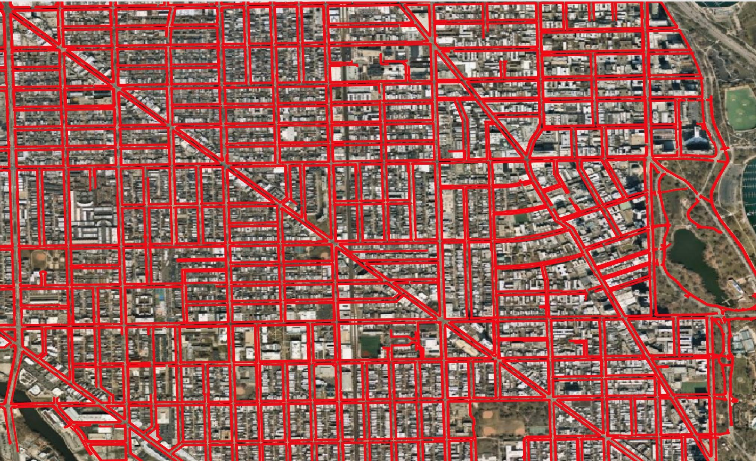
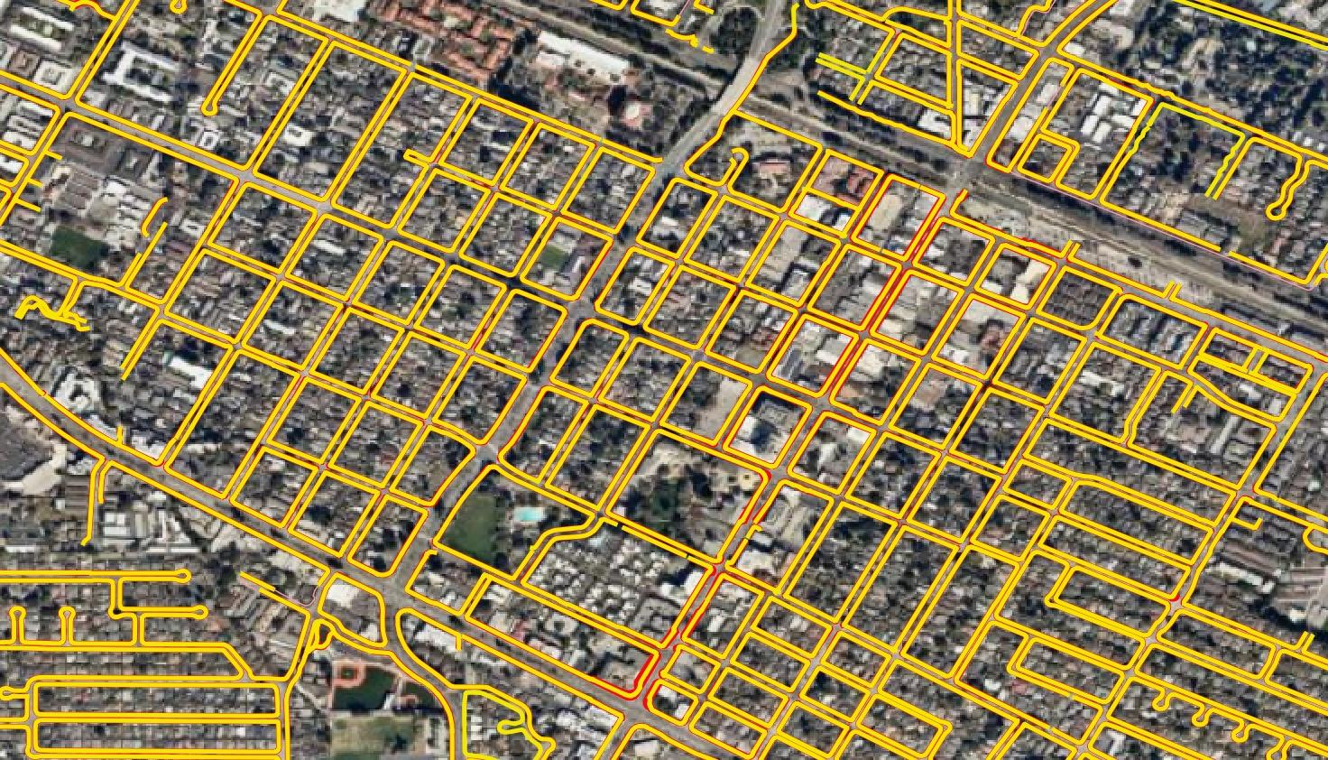
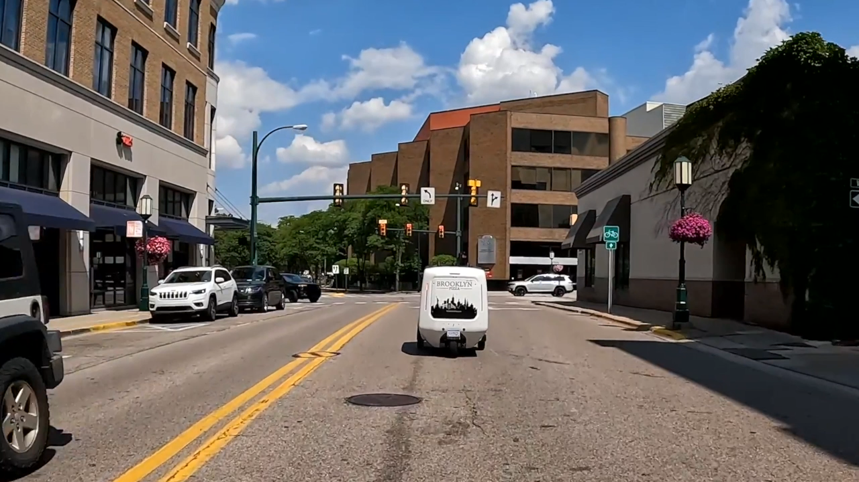
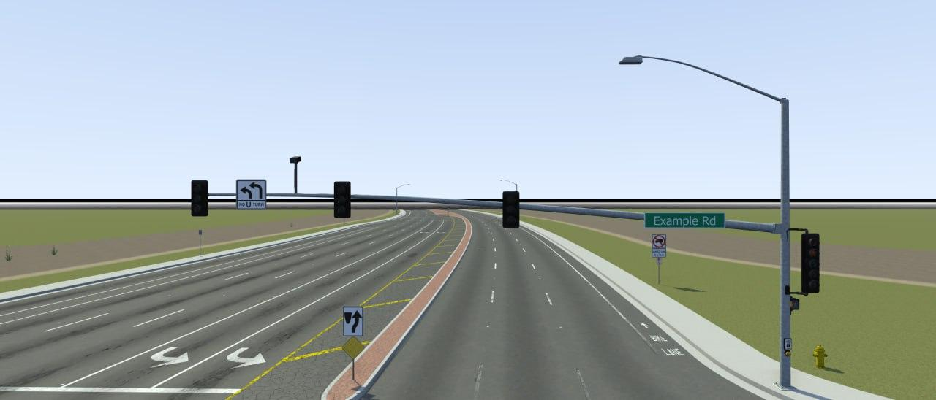
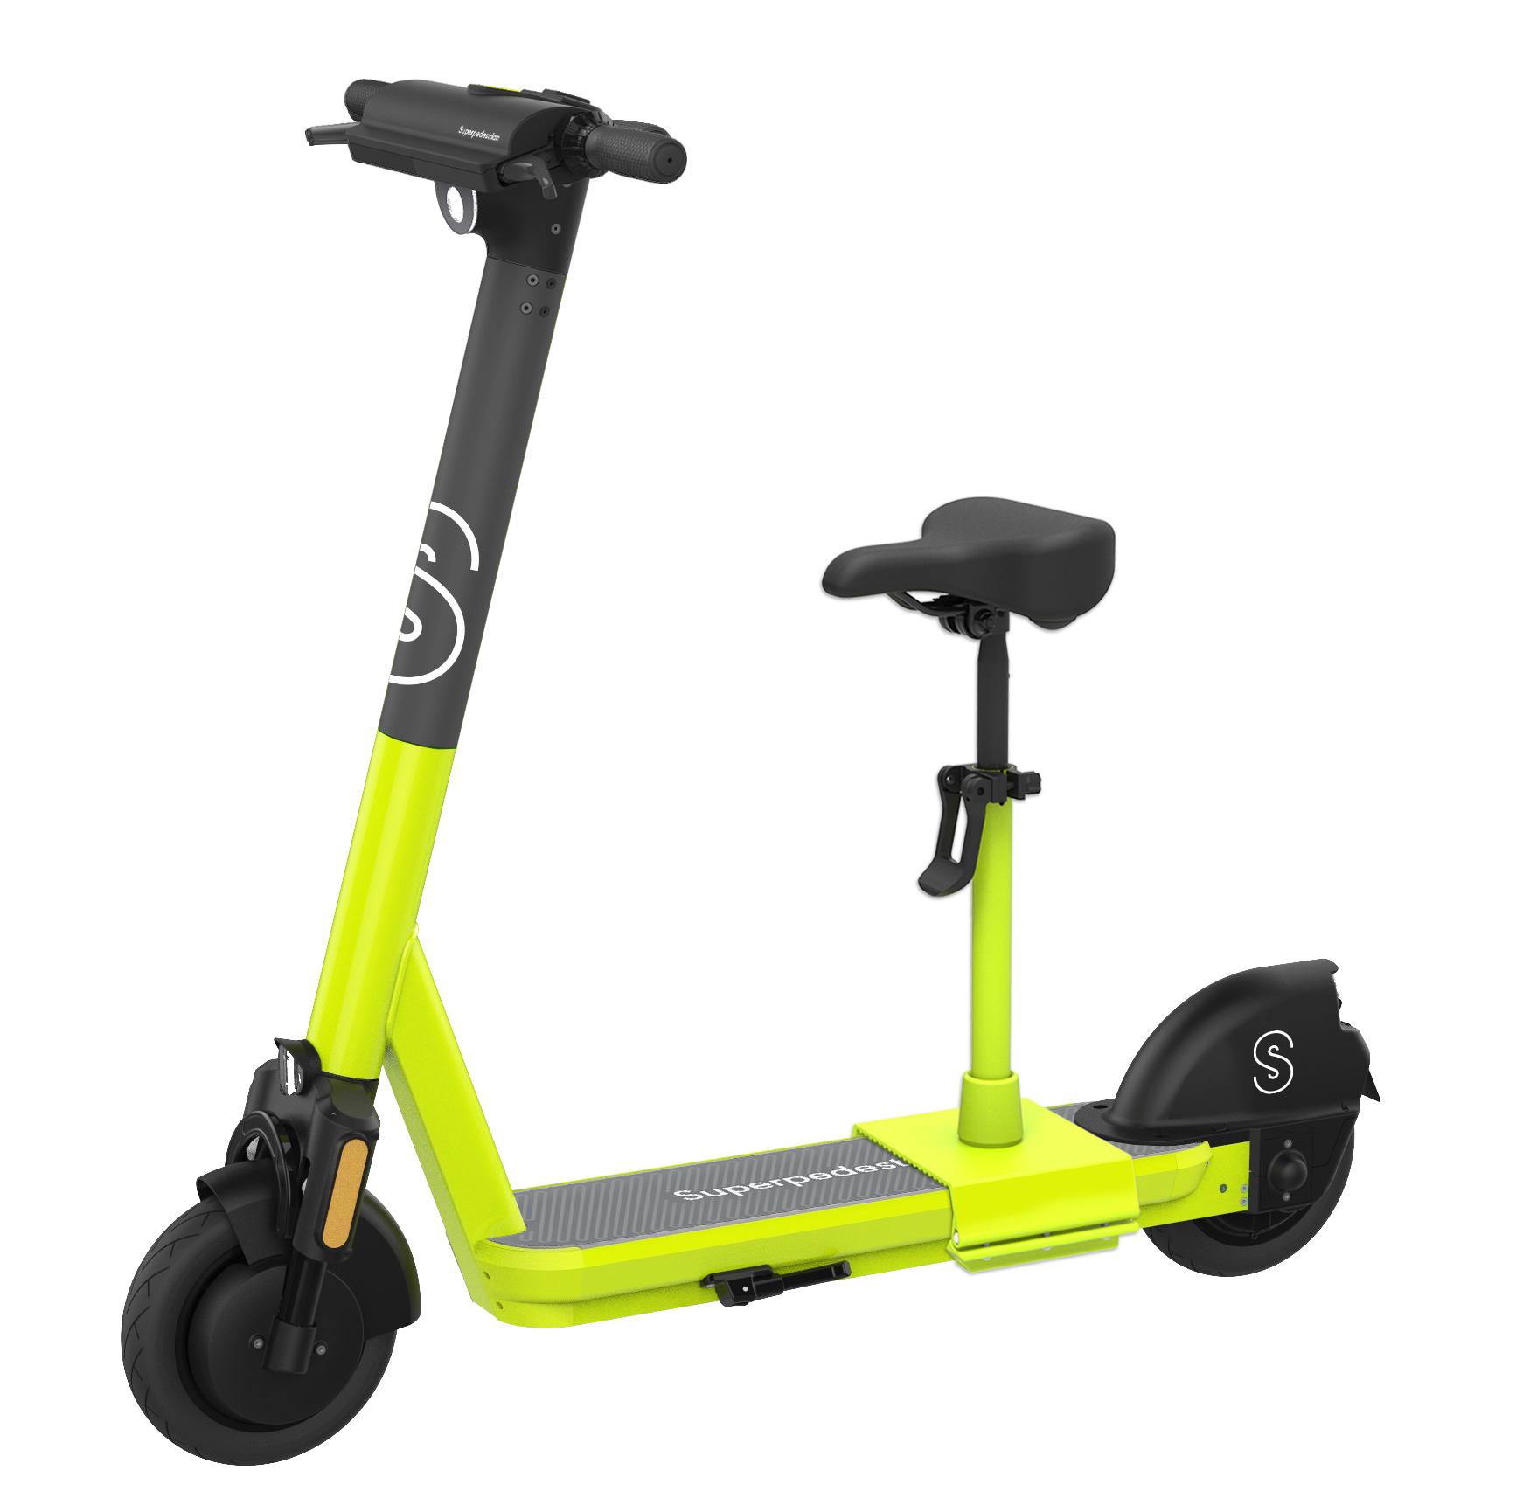
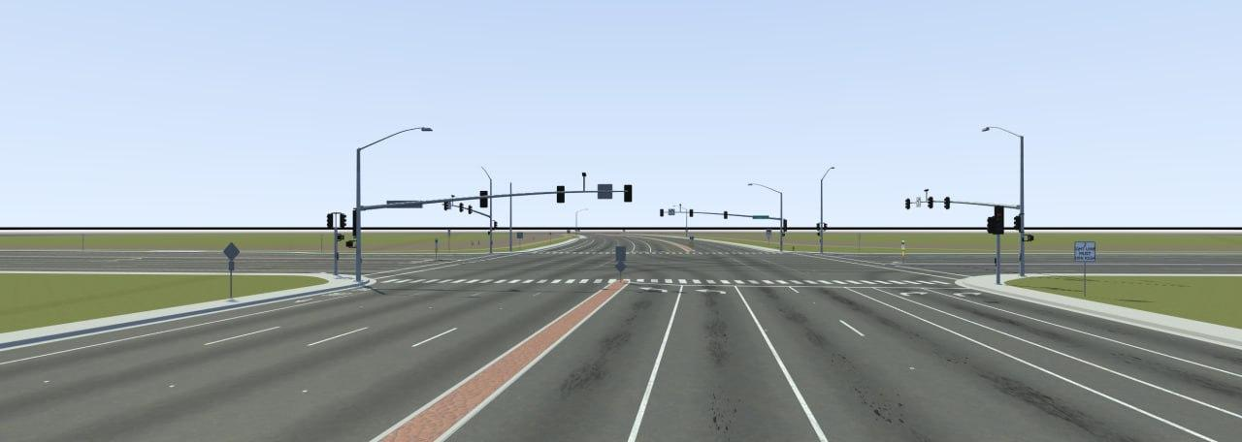
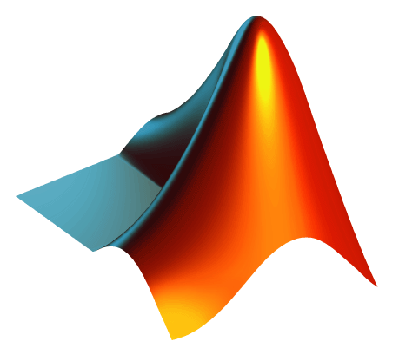




Examples of Delivered Projects
Qualicum Beach - Tree Canopy Extraction
Mathworks for 3D built cities
Super Pedestrian in Chicago, IL
Mountain View, CL
Magna in Birmingham, MI
Oakville, ON
Notes:
Now we have come to the sweet part!
So far, we have completed multiple projects for smart mobility providers. These are only a few examples.
Magna deployed their delivery bots in Birmingham Michigan using our high definition maps which provide the necessary level of detail and precision for reliable and secure navigation.
Super pedestrian is using our technology to geofence sidewalks and actively engage with riders avoiding the sidewalk and provide safe environment for all pedestrians
We worked with Oakville to map bikelanes as a part of their vision zero initiative
Ottonomy deployed robot delivery in Bradely Uni Campus using our technology
And in MV we helped city to have an accurate map of connected pedestrian network as a part of their vision zero plan
Last but not least we have partnered with Mathworks to create 3D environments for AV simulations.
All of these made possible by our proprietary mapping and automation that harness the power of AI but still we are actively working on our pipeline to enhance methods and improve the accuracy to minimize human provisioning and make map creation faster everyday

Slide 7
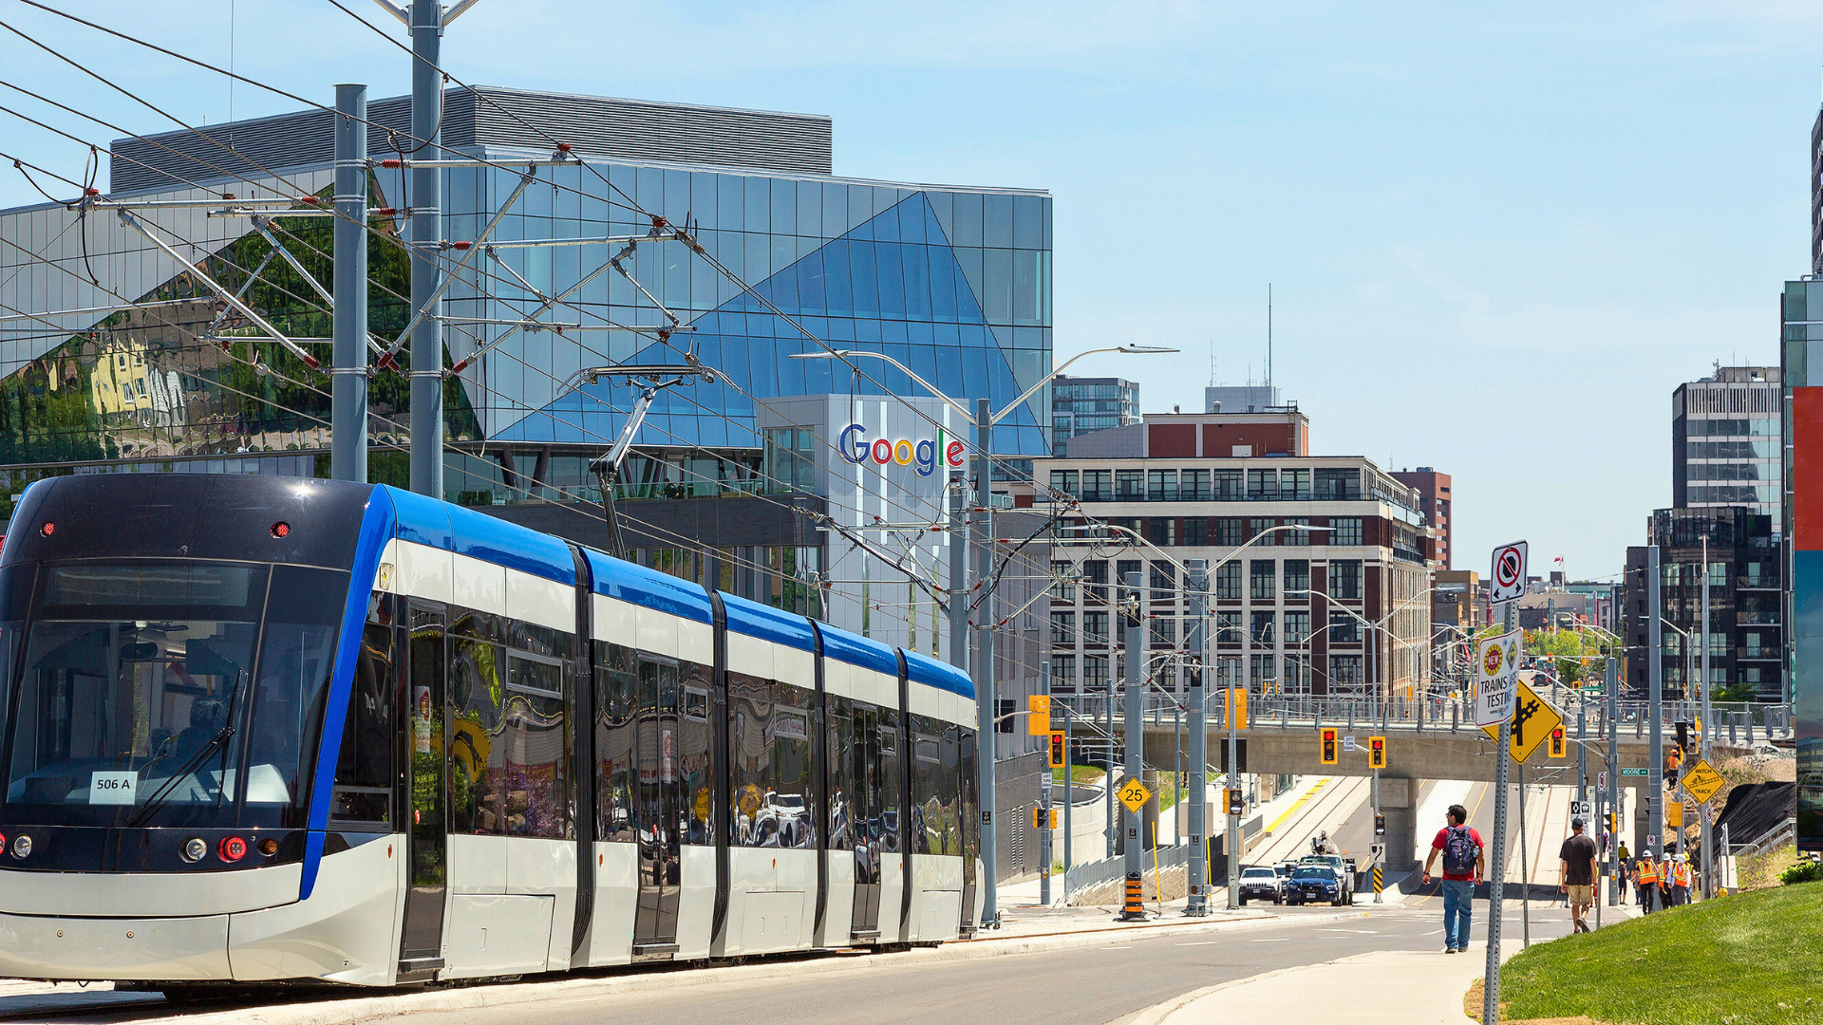
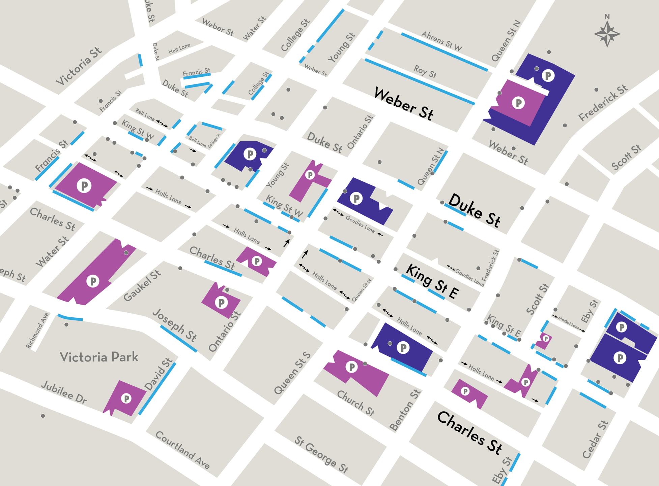
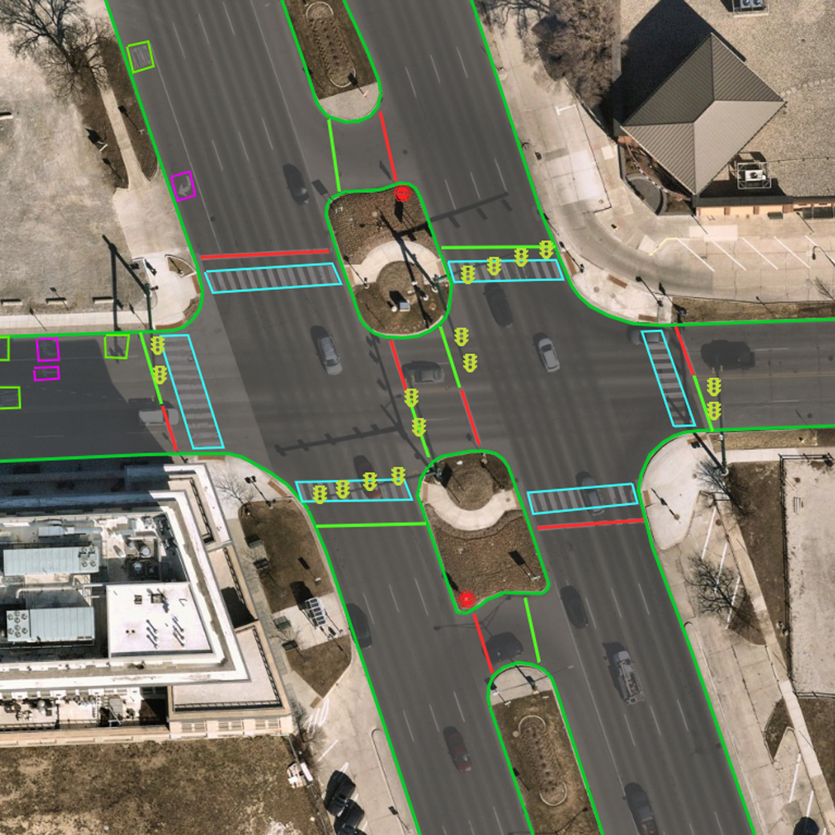
HD Mapping Applications in Kitchener
Transit Accessibility:
Improve connectivity between transit hubs and key destinations like the Kitchener Memorial Auditorium, LRT to Airport, and Train Station.
Parking Optimization:
Utilize HD mapping to optimize existing parking spaces, avoiding the need for costly new structures.
City Works Projects:
GeoMate’s data set will provide high accurate information on asset location for city works projects
Notes:
City works use-case - GIS creates the features and then the service requests run through. Our dataset will provide highly accurate information on asset location for these service requests.
Notes from Brian based on last OCI prep meeting:
Motivation from City of Kitchener: Innovation lab at Commnuitech,
They want to be at the table for things
Courtney actually moved on from the lab part of things
Need for the technology?
How does it benefit them, Waterloo Ring Road experimentation. Private road.
They can start to plan for AV's, Brian told a story about Kitchener's AUD and how they can use AV's to link the LRT to points of interest. The LRT is seen as the spine of the City, how can we better connect it to things at the AUD.
OEM positioning won't get funded. The story that needs to be pulled is that the City needs this.
OEM is the long term play

Slide 8


Robert MacGregor
Director of Partnerships
+1 (647) 955-2635
robert.macgregor@geomate.ca
https://www.linkedin.com/in/robert-c-macgregor/

