Slide 1








Cybersecurity for CAVs
Webinar
MODERATOR
Sherin Abdelhamid
Technical Advisor of the
Autonomous Vehicle Innovation Network (AVIN) at OCE
Tue., 25 February 2020
2:00 PM – 3:00 PM EST
SPEAKER
Noemi Chanda
Senior Manager, Data Protection
and Privacy Practice
at Deloitte Toronto

Slide 2
The Connected and Autonomous Vehicle (CAV)
What is a connected and autonomous vehicle?
A connected and autonomous vehicle can be referred to as a combination of various IoT devices with the capability to communicate with its surrounding physical and digital environment.
Transport Canada defines a ‘Connected’ and ‘Autonomous’ vehicle as the following:
Vehicles using different types of wireless communication technologies to communicate with their surroundings.
Vehicles that can perform at least some (or a lot of) driving functions, without depending on a human driver.
Cybersecurity risks are particularly complex for CAVs, as they operate across both the physical and digital world, and both consume and create data, while communicating with the surrounding ecosystem.
Physical
world
CAV
Digital
world

Slide 3
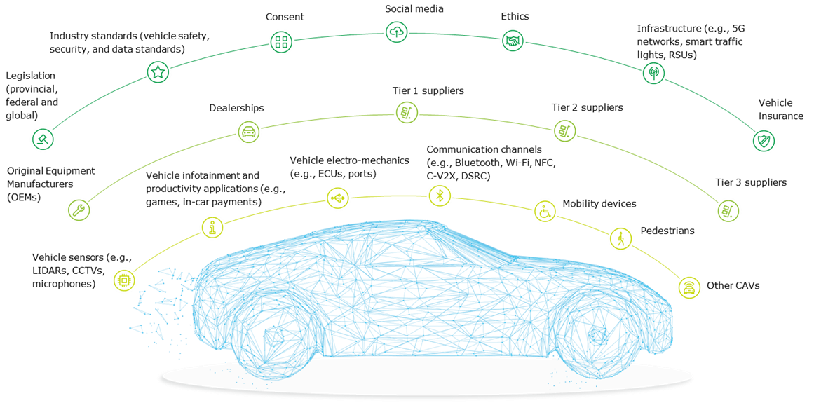
Interconnected CAVs
As the number and speed of communication channels with vehicles have increased, there has been an increase in malicious attacks on vehicles. Connectivity from inside or close to the vehicle, to key third parties, and the surrounding environment adds complexity to the ability to respond effectively to threats.
Layer 3
Layer 2
Layer 1
Layer 1: Within and near to the vehicle
Layer 2: Supply chain
Layer 3: Extended ecosystem and relevant considerations

Slide 4
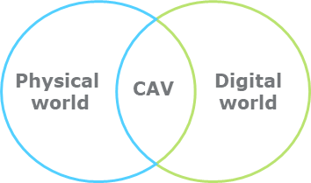
Threats, influences, and impacts to CAVs
Consumers are driving the demand for better connected, integrated vehicle services – but as more sensitive information about vehicles and their occupants is being collected and shared, vehicles are increasingly a valuable target for threat actors. These can result in major impacts to physical property and data, presenting fraud, privacy, and safety challenges.
Key threats to CAVs
Threats influencing cybersecurity risks in smart cities
Insider threats
Cyberattacks into V2X (Vehicle to Everything) Communications
Hijacking Vehicle Sensors and Taking Over Physical Controls
Dumpster Diving for Data
Supply Chain and 3rd Party Risks
Convergence: Physical and cyber world
Interoperability: Coexistence and frequent interactions between old and new systems and platforms
Integration: Integration and comingling of services across domains through IoT and digital technologies

Slide 5
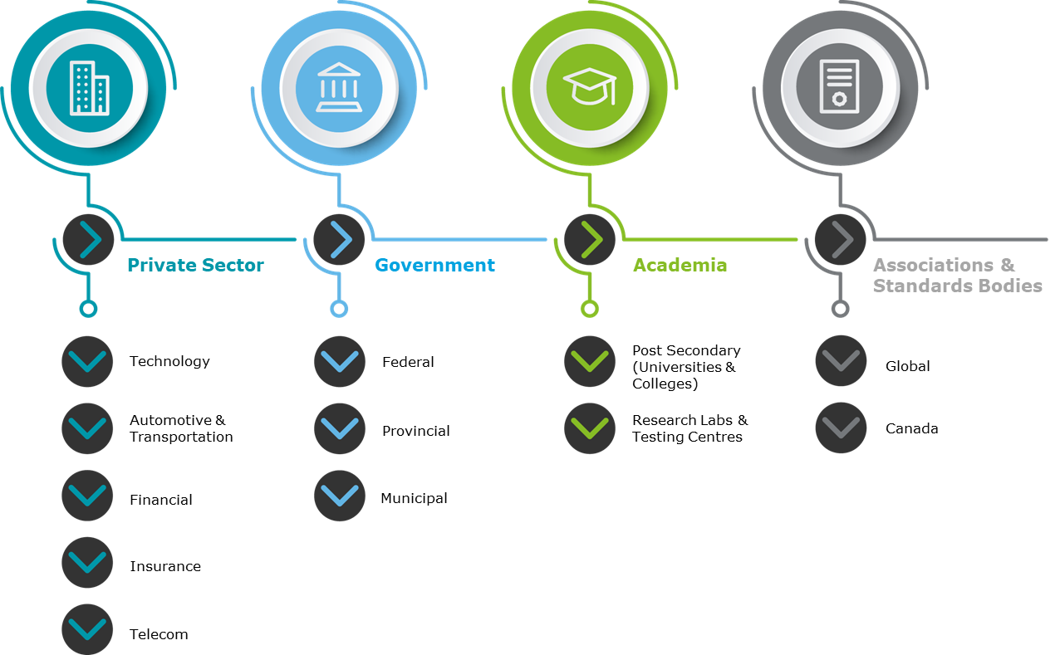
The complex CAV stakeholder ecosystem
The CAV cybersecurity ecosystem is made up of a variety of interconnected stakeholders.
The Autonomous Vehicle Innovation Network (AVIN), Deloitte, and the Automotive Parts Manufacturers’ Association (APMA) of Canada developed a report to identify key areas for consideration for CAV cybersecurity and avenues for growth and development.
The stakeholders included within this report span several sectors and sub-sectors across the private sector, government, academia, associations and standards bodies.

Slide 6
Key CAV cybersecurity considerations – the stakeholders’ voice
Lessons learned from our global research and CAV stakeholder responses included that authentication and trust will be a key challenge across the CAV ecosystem and that the entire extended security perimeter must be considered, with a focus on cloud security, in-vehicle security, and network security.
Governance
Secure
Vigilant
  Resilient
Accountability
Standards (e.g. ISO, NIST, etc.)
Ethics
Retention and recruitment
Authentication and trust
Assurance
Patching
Penetration tests (or ethical hacking)
Phishing attacks
Threat intelligence
Security updates
Monitoring security events
Business Continuity Management (BCM)
Incident Response (IR)
Supplier stress tests
Key themes from
stakeholder responses

Slide 7
Key CAV cybersecurity considerations – standardization, collaboration, training and trust
In the context of emerging threats, the following considerations add complexity to being able to respond to and manage CAV cybersecurity risks.
Standardization & Enforceability
Transparency & Collaboration
Lack of transparency and cooperation on cybersecurity challenges within the automotive industry (e.g., gap between research/academia and industry).
Absence of unified requirements, lack of clear regulatory requirements and enforcement.
Ecosystem Themes
Training & Development
Trust
Difficulty ensuring assurance of products and services across the supply chain and trust of providers and communications.
Difficulty attracting and retaining cyber talent. High demand and low supply for cybersecurity talent.

Slide 8
Global cybersecurity developments in the CAV landscape
In Canada and globally, governments are increasingly considering and embedding cybersecurity into their CAV strategies, assessment tools, and laws.
0.77"
Canada
United
Kingdom
USA
Canada
Transport Canada created a safety assessment tool which will be used by companies that design vehicles with an Automated Driving System.
0.77"
Singapore
Singapore
Singapore released TR68 (Transport Reference 68). This standard covers four key areas of AV development with a focus on cybersecurity and the interoperability of data.
USA
The US Department of Transportation (DOT) released the “Automated Vehicles 3.0: Preparing for the future of transportation”.
United Kingdom
The Key Principles of Cybersecurity for Connected and Autonomous Vehicles
were developed by the Department for Transportation (DFT) towards the development, testing and deployment of CAVs.

Slide 9





Industry driven cybersecurity standards and regulations
Industry associations and standards bodies around the world are developing important cybersecurity guidance with direct applicability to CAVs.
The BSI Publicly Available Specification (PAS 1885:2018) is designed to be read in conjunction with the United Kingdom’s Key Principles of Cybersecurity for Connected and Autonomous Vehicles.
&
ISO and SAE are developing a new joint standard, ISO/SAE 21434 Road Vehicles – Cyber Security Engineering.
International organization for standardization
Society of Automotive Engineers
British Standards Institution
The SSC’s manufacturing Standards Committee, along side with other authorities and development organization supported the development of the Technical Reference 68 (TR68) standards for autonomous vehicles.
The NIST considerations for Core Internet of Things (IoT) Cybersecurity Capabilities Baseline was released in February 2019. This initiative will involve a collaboration between NIST and stakeholders to develop a cybersecurity baseline.
National Institute of Standards and Technology
Singapore's Standards Council

Slide 10
Cybersecurity innovation models in the CAV ecosystem – a collaborative approach
In response to complex threats to CAVs, innovation across cybersecurity, technology, and manufacturing experts that had traditionally occurred in siloes is converging.
Cybersecurity
Collaborative approach
Technology and cybersecurity companies are developing innovative partnerships with manufacturers across the supply chain.
For example, cyber start-ups offer expertise to manufacturers and work with technology start-ups to build technologies that can address emerging cyber threats to CAVs (e.g., integration of AI technologies).
Technology
Manufacturers

Slide 11



Trends in the CAV cybersecurity innovation ecosystem
Organizations in the cybersecurity space are contributing to the CAV ecosystem through the following approaches:
Partnerships and Proof of Concepts (POCs) with manufacturers
In specific instances, no internet connection required to provide cyber protection
Innovation in cybersecurity using AI and blockchain

Slide 12
Key global opportunities – standardization, innovation, testing, and market growth
Stakeholders across the CAV landscape globally are identifying cybersecurity as a critical component to ensuring the safety and security of the future of mobility, and have identified opportunities to collaborate across government and industry.
Standardization, certification and legislation
Skilled talent growth and retention
Collaboration and partnerships across industries
Trust and authentication innovation
Bringing OEM and technology innovation to market
Convergence security testing
Privacy and security by design; ethical frameworks

Slide 13



Approach to new solutions in the CAV ecosystem
Cybersecurity innovations in the CAV ecosystem are moving from ideas, to product and service development, and finally to market – finding and developing solutions to meet interoperability, scale and implementation challenges.
Ideas innovation
Solution development
Market innovation
Understanding needs and getting the right focus
Research and ecosystem analysis to identify key cybersecurity risks and challenges, and what is needed to successfully mitigate them.
Getting the concept right
Turning innovation into reality through research, testing, and development; looking to launch in the market.
Scaling the solution
Once the solution is refined and ready for market, innovating to meet interoperability, scale and other implementation challenges.

Slide 14


Recent Ontario developments in CAV testing and CAV cybersecurity
Ontario has been involved in various discussions and cybersecurity activities relevant to CAVs. The outcomes of these discussions have seen Ontario taking proactive steps towards a more secure and innovative CAV ecosystem.
Some recent developments within Ontario include:
Policy Planning and Support Committee (PPSC) working group
A 2019 update to the Ontario automated vehicles testing pilot program in response to advances in CAV technology.
The Government of Ontario co-chaired the development of the Canadian policy framework for CAVs. This framework highlights both cybersecurity and privacy as important vulnerabilities, and provided recommendations.
In Ontario, the government funds various programs, such as the AVIN Talent Development program, to harness and develop talent in the automotive industry.

Slide 15
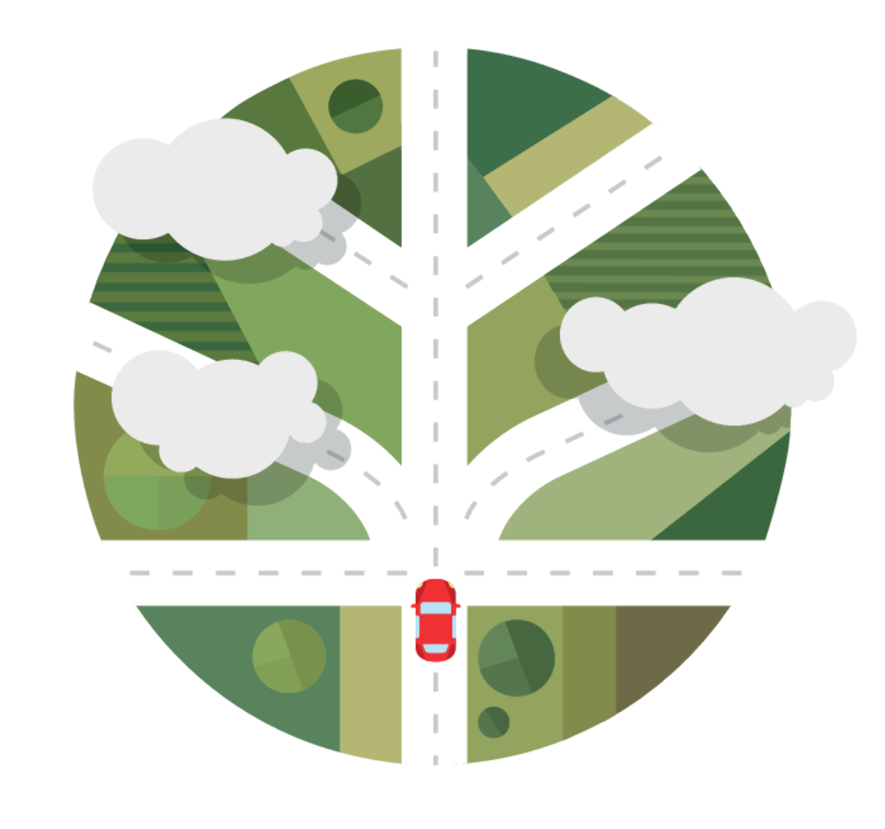
Key opportunities for Ontario
As CAV cybersecurity continues to grow in importance and gain traction across governments, AVIN looks forward to continuing to engage with the entire CAV ecosystem to enable the future of CAV cybersecurity in Ontario.
Key opportunities
Organizational privacy and security awareness and increased maturity
Cross-border partnerships for CAV cybersecurity
Standardization and a certification process for CAV cybersecurity
Research, testing and development of CAV cybersecurity
CAV cybersecurity internships and job placements

Slide 16
Q & A
THANK YOU
Noemi Chanda, MA, JD
nchanda@deloitte.ca
www.deloitte.ca
Sherin Abdelhamid, PhD
sherin.abdelhamid@oce-ontario.org
www.avinhub.ca

